Slide 1
Teck Resources: Fueling a better tomorrow
QDS HACKS 2023: TURNING DATA INTO INSIGHTS
Team Atari: Wendy, Justin, Elizabeth, Mike, Matthew
Notes:
Hi my name is ___ and we are Team Atari.

Slide 2
Objective
To create a more sustainable mining operation by reducing fuel consumption and greenhouse gas emissions
Notes:
The objective of our project is to create a more sustainable mining operation by reducing fuel consumption and greenhouse gas emissions.

Slide 3



Our approach
Identify trends in the data​
Find variables with greatest impact
Design a user-friendly format​
Notes:
We focused on data set 0
Identify trends in the data that revealed opportunities to increase the efficiency of mining operations.
Specifically, five out of the nine shovels did not deliver any payload to any haul truck, but were nevertheless consistently visited by almost every truck and several dumps did not receive any payloads.
Efficiency would be increased by bypassing these inactive shovels and dumps.
We created a desktop application that provides a map of the most efficient route to travel from shovel to dump given user input.

Slide 4
walkthrough
Notes:
Walkthrough of data extraction process
Assumed random grid time zone ( in the Atlantic ocean) that fit all of our gps northing and gps easting points so we were able to convert UTM coordinates to longitude and latitude ( We chose 44 N according to 32
Explanation of how results are generated
Shovels 1, 2, 3, and 6 are active

Slide 5
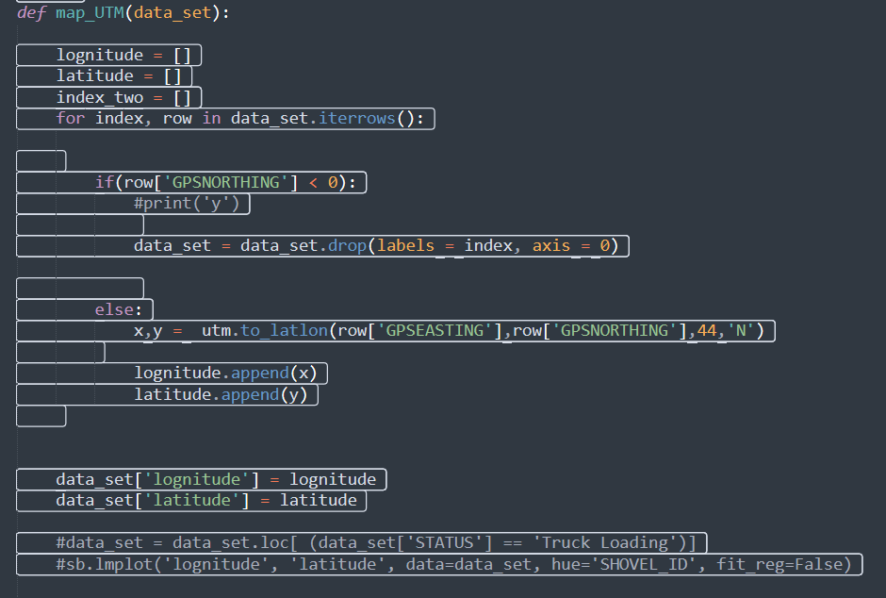

Slide 6
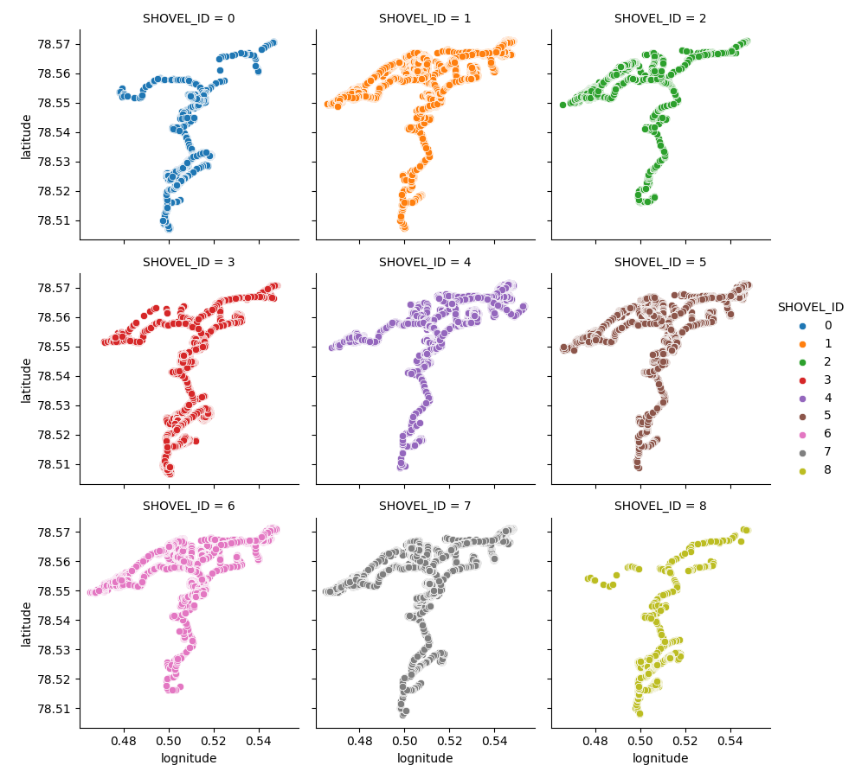

Slide 7
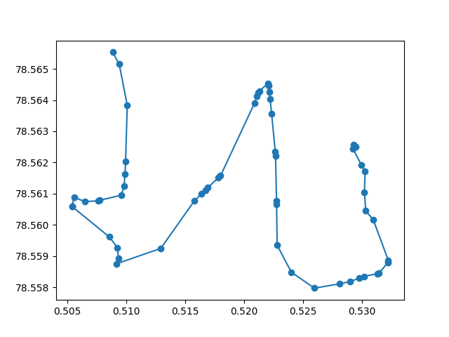
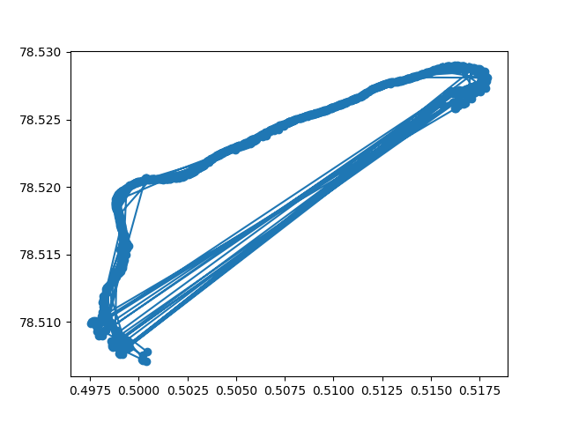
Notes:
Example: Entering Truck ID and Shovel ID – Resulting optimal route display
Find least average mean of fuel consumption rate from active shovel ID to an active Dump ID
Algorithm would return a value that would ask user for Shovel ID, so that if the Shovel ID is inactive, it will tell the user to find a different Shovel ID and stop the program
Algortihm would only show routes in which DumpIDs are active, so that Truck Drivers don’t have to waste gas to try to find an open dump site
Assumption :
Assumed that the route to and from the Shovel ID and the Dump ID are always the same
That payload is never zero
That the status was always hauling

Slide 8
wireframe
Notes:
Demonstration

Slide 9
benefits
Optimized vehicle routing
Efficient scheduling of trucks
Notes:
Increase productivity through less queuing and idle time
Reduce or eliminate vehicles going to shovel or dump sites that are inactive
Decreased costs through fuel savings
Greater sustainability through decrease in GHG emissions
Optimized vehicle routing: Less travel time can be used to deliver the same amount of material from one shovel site to one dump site by bypassing inactive shovel and dump sites
Efficient scheduling of trucks:

Slide 10
Future opportunities
Level-load truck allocation
Map elevation correlation with payload
Truck type allocation
Notes:
Allocate trucks to dumps evenly to avoid queuing
Provide third dimension to mapping features
Allocate the most appropriate truck type for certain routes

Slide 11
Thank you
QUESTIONS?

